Slide 1
Real Time Parking Space Availability
Gopi Sai Surekha Kotiyala
With
Dr. Terry Griffin
Midwestern State University

Slide 2
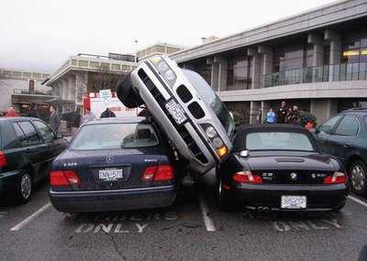

Problem
Late for class … again.

Slide 3
Motivation
Available parking spaces are elusive.
Identifying available parking is not easy to implement, but possible, and has an expressed need.
Machine learning has made this possible.
More cost effect method than using sensors.

Slide 4
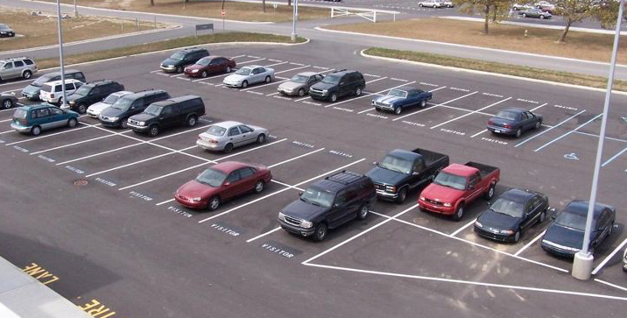
Overview
Identifying Available Parking Spaces has three stages:
Automatic parking space discovery
Identifying spaces as available
Mobile application showing results in real time.

Slide 5
Some Terminology
Feature Detection
Filtering
Color Identification
Machine Learning
Neural Networks
Layers
CNN
Activation Functions

Slide 6
Problem statement
Examples of parking lots
Examples of bolin
Possible solutions
Sensors
Counting entrance and exit
Image process / machine learning
Define / discuss image processing
Color histograms
Line detection
etc
Classification
Classification problems
Color (daylight)
Weather
Shadow
Motorcycles
Clouds
Dogs and Cats vs Signs
Machine Learning
Neural Networks
Training vs Testing (validating)
CNN
Layers
Activation Functions (sigmoid etc)
Back propagation
Dogs and Cats tutorial
App demo
Ionic and cordova and firebase
Future work

Slide 16

Application
( on a clean image)

Slide 17

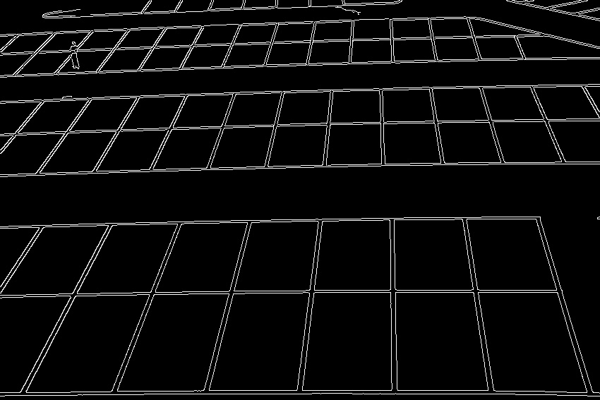
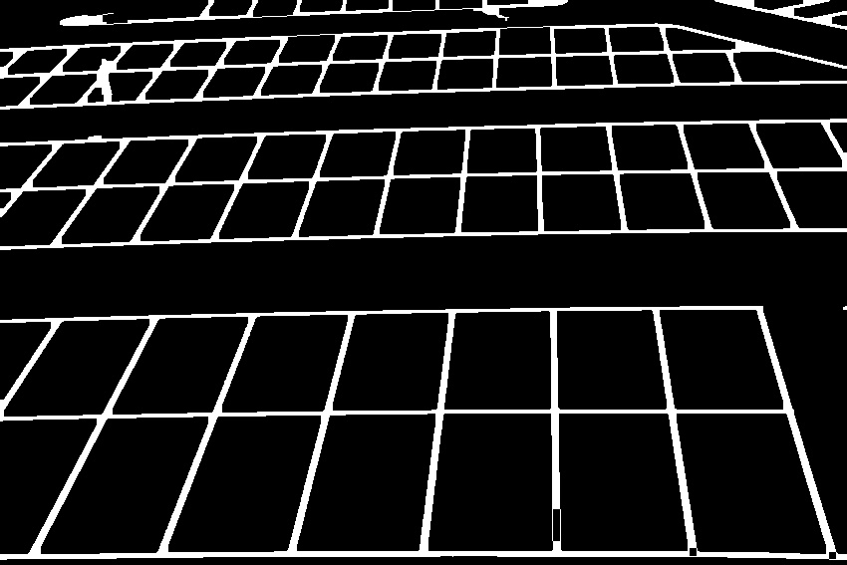
Application
( filters )
Original
Gray Scale
Edged
Closed

Slide 18
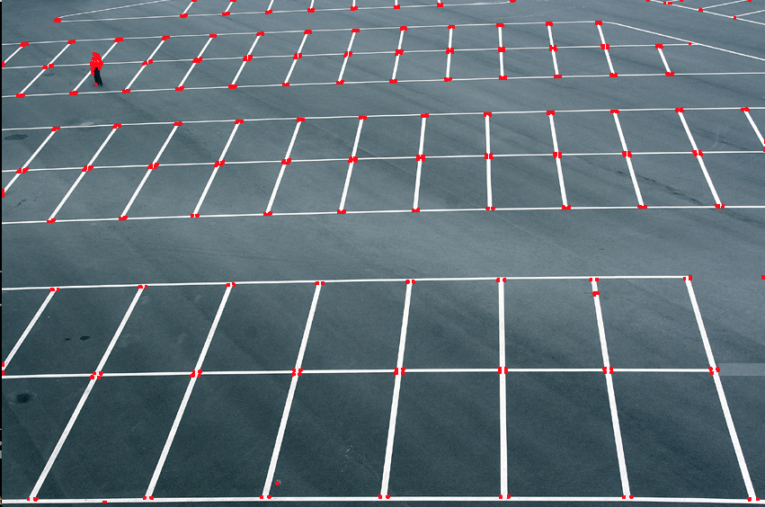
Application
( Corners)
Corner Detection

Slide 19
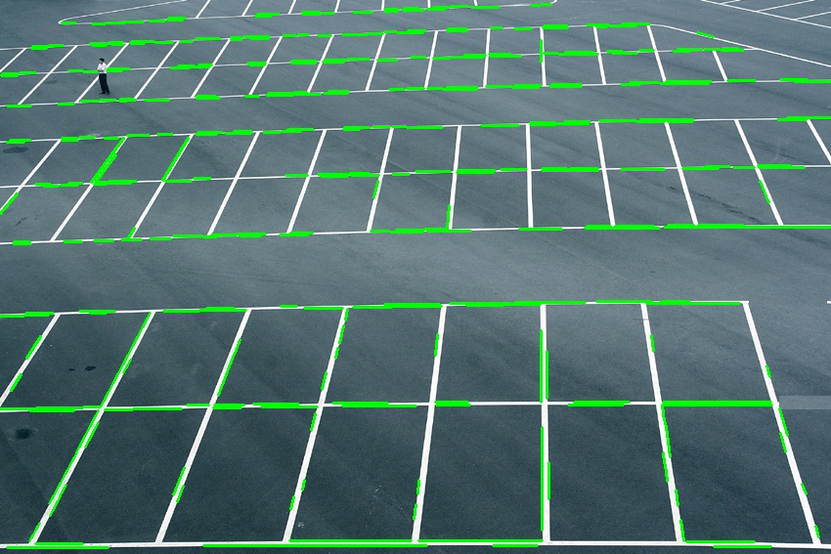
Application
( Lines)
Line Detection

Slide 20
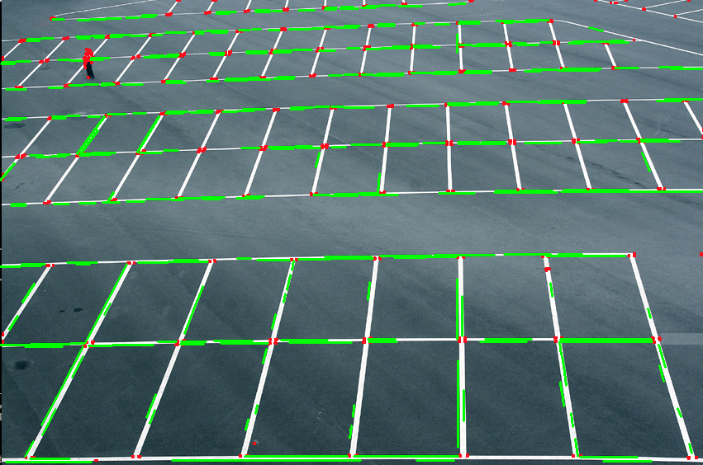
Application
( Lines and Corners)

Slide 21
Problems
A real time robust parking space identification algorithm is possible, but not 100%
We choose to move to Stage 2
Automatic parking space discovery
Identifying spaces as available
Mobile application showing results

